Slide 1
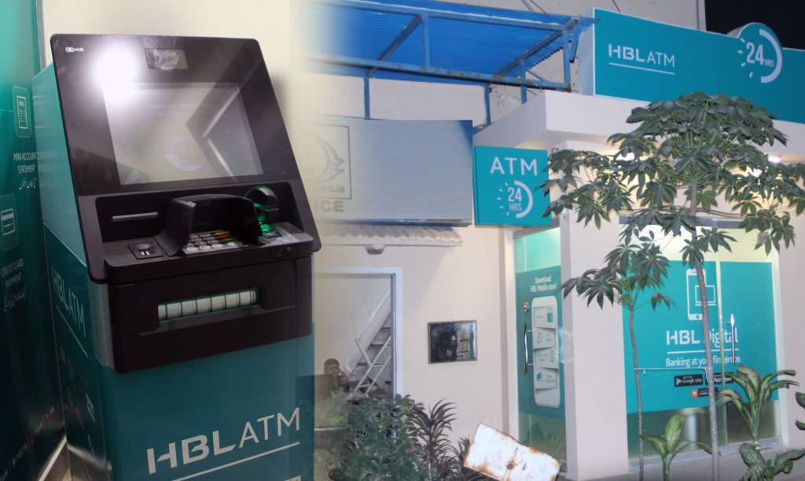
AUTOMATED TELLER MACHINE
APPROVED BY: PROF. NOOR ULLAH KHAN

Slide 2

TEAM MEMBERS
TEHREEM MEHMOOD (49140)
ALEEZA NADEEM (48718)

Slide 3

INTRODUCTION
ATM Simulator is developed using C++ Programming Language and is based on a concept of managing cash transactions of a personal account. The user can manage amount activities such as withdrawal, deposits, and balance inquiry.
This ATM Simulator is a mini project to that of real ATM.
40-60%
3
Market Growth Per Year

Slide 4

FEATURES
Login Pin System
Withdrawals
Quick Cash
Deposits
Check balance
Funds Transfer

Slide 5

Why we use OOP in our project?
Modularity and Reusability: OOP allows you to organize code into modular components called classes. Each class encapsulates data and related functions, making the code easier to understand, maintain, and reuse.
In an ATM Simulator, you can create classes such as User, Account, Transaction, and ATM, which
can be reused in different parts of the program or in future projects.
Encapsulation: OOP promotes encapsulation, which means bundling data and related functions into a single unit (class) and hiding the internal details from other parts of the program. This enhances security and reduces the risk of data corruption.
In an ATM Simulator, you can encapsulate sensitive data, such as user transaction details, within
appropriate classes, providing a layer of protection.

Slide 6

Abstraction: OOP allows you to create abstract classes and interfaces that define common behaviors and properties without specifying the implementation details. This abstraction simplifies the program structure and allows for easy modification or extension in the future.
In an ATM Simulator, you can define an abstract class for a generic transaction and derive specific
transaction classes (withdrawal, deposit, transfer) from it.
Inheritance: Inheritance is a key concept in OOP that allows you to create new classes (derived classes) based on existing classes (base classes).
In an ATM Simulator, you can create a base class, such as Account, and derive different types of accounts
(e.g., savings, checking) from it. This promotes code reuse and allows for specialized behavior and attributes for
account type.
Code Maintainability: OOP principles promote code maintainability by providing a clear structure and separation of concerns. It allows developers to work on different modules independently, making the codebase easier to understand, update, and debug. This is especially important in large projects like an ATM Simulator.

Slide 7

APPLICATIONS:
Training and Education
Customer Onboarding
Software Development and Testing
Financial Literacy Programs
Research and Analysis

Slide 8

Thank YOU

